Slide 1
Arrays and Structs
COS 1020 C++ Programming
AUBG COS Department
Based on chapter 9 – problem solving, abstraction and design using C++, Friedman & Koffman

Slide 2
Lecture Contents
9.1 The Array Data Type
9.2 Sequential Access to Array Elements
9.3 Array Arguments
9.5 Searching Arrays
9.7 Multidimensional Arrays
9.8 The struct Data Type
9.9 Structs as Operands and Arguments
9.10 Array of Structs

Slide 3
The Array Data Type
An array is a collection of data items, associated with a particular name
Array elements have the same type – the base type
We can reference individual elements by using the array name and the element’s position, starting with 0
  scores[0] = scores[9] + 20;
Array elements are stored in consecutive memory locations

Slide 4
Additional Array Details
Subscripts are denoted as expressions within brackets:
  grades[1] // 2nd element
Base type can be any built-in, library-defined, or user-defined data type:
  int, double, char
  string
  Vehicle, Car
The index type is integer and the index range must be 0 to n-1, for array of size n

Slide 5
Array Declaration
element-type array-name [array-size];
Example:
float x[5];
Type of all the values in the array
Name of the entire collection of values
Integer expression indicating number of elements in the array

Slide 6
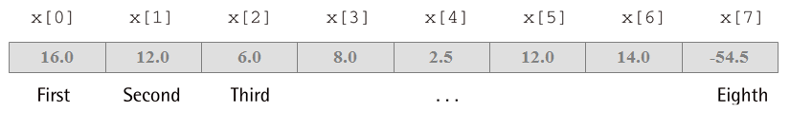
Example: Array Declaration and Initialization
element-type array-name [array-size] =
{initialization-list};
Example:
float x[8] = { 16.0, 12.0, 6.0, 8.0, 2.5, 12.0, 14.0, -54.5 };

Slide 7
Array Initialization
You can specify the initial contents of an array as part of its declaration by providing the initial values enclosed in braces ({}) following an assignment operator (=)
Values from the initialization list will be assigned in the same order to the corresponding array elements
The length of initialization list cannot exceed the array size
The size of the array can be automatically set to the size of the initializer list by using empty brackets ([]):
  int arr[] = { 1, 2, 3 };

Slide 8
Array Subscripts / Indexes
To access an individual element of an array, we provide its subscript / index (zero-based position) in brackets:
  arr[0] = arr[1] - 5;
The array subscript is different than array element value
Subscript can be an expression of any integral type
To be valid, the index must be a value between 0 and array size - 1

Slide 9
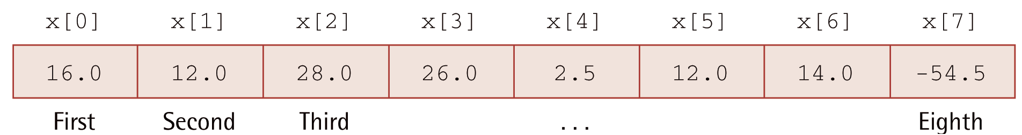
Example: Array Declaration and Initialization (continued)
cout << x[0];
x[2] = 25.0;
sum = x[0] + x[1];
sum += x[2];
x[3] += 1.0;
x[2] = x[0] + x[1];

Slide 10
Example: Parallel Arrays
const int NUM_EMP = 10;
bool onVacation[NUM_EMP];
int vacationDays[NUM_EMP];
enum day {
sunday, monday, tuesday, wednesday,
thursday, friday, saturday
};
day dayOff[NUM_EMP];
float plantHours[7];

Slide 11
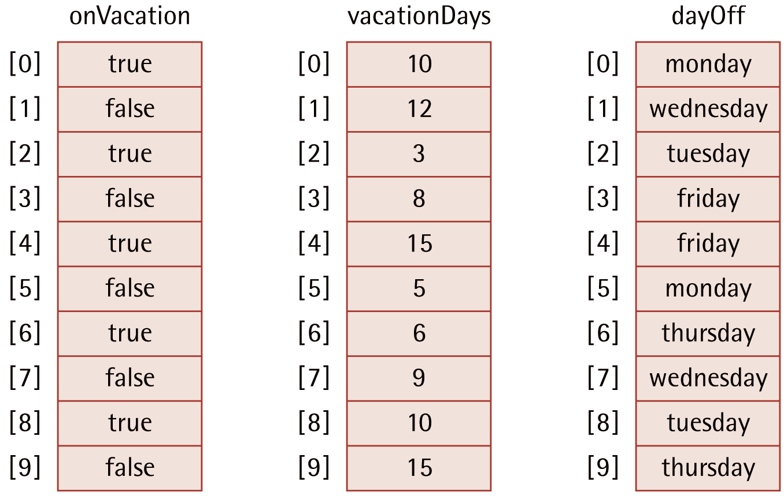
Arrays onVacation, vacationDays and dayOff

Slide 12
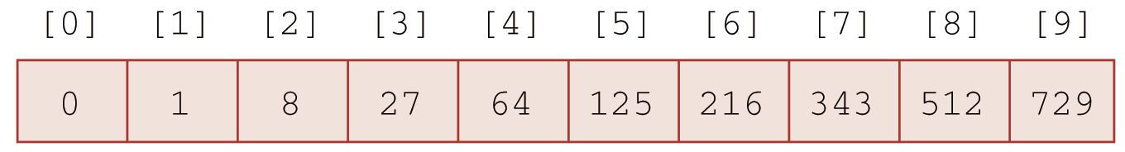
Sequential Access to Array Elements
As long as you know the size of an array, you can use a loop to iterate through all elements:
int cube[10];
for (int i = 0; i < 10; i++)
cube[i] = i * i * i;

Slide 13
Strings and Arrays of Characters
A string object uses an array of char
Can reference an individual character of a string object in different ways:
name[i]
name.at(i)
Other member functions of the string class:
  message.length()

Slide 14
Call-by-Value Function Parameters
The default parameter passing mechanism where the value of the argument is copied as the value of the function parameter
void foo(int a) {
a = a + 5;
}
int x = 5;
foo(x);
cout << x; // 5
a = 5
a = 10
x = 5
a = 10

Slide 15
Call-by-Reference Function Parameters
In call-by-reference the address of the actual argument is passed and through that address the called function can update the actual argument value
void foo(int& a) {
a = a + 5;
}
int x = 5;
foo(x);
cout << x; // 10
x = a = 5
x = a = 10
x = 5
x = 10

Slide 16
Call-by-Reference Function Parameters (continued)
void foo(int& a) {
a = a + 5;
}
int x = 5;
foo(x); // OK
foo(5); // WRONG!

Slide 17
Array Arguments
We can pass array elements to functions:
  exchange(s[3], s[5]);
We can also pass an entire array to a function by writing its name with no subscript in the argument list of the function call:
void printArray(int arr[], int size) {
for(int i = 0; i < size; i++)
cout << arr[i] << endl;
}
int nums[] = { 1, 2, 3 };
printArray(nums, 3);

Slide 18
Passing an Array Argument
Arrays are always passed by reference
Pass an entire array to a function by writing just its name (no subscripts or brackets) in the argument list of the function call
In a function definition and prototype, use empty brackets ([]) to identify an array
Use the keyword const to indicate that the array argument cannot be changed by function

Slide 19
Example: Adding Two Arrays
const int MAX_SIZE = 5;
float x[MAX_SIZE] = { 1.8, 2.2, 3.4, 5.1, 6.7 };
float y[MAX_SIZE] = { 2.0, 4.5, 1.3, 4.0, 5.5 };
float z[MAX_SIZE];
...
addArray(MAX_SIZE, x, y, z);

Slide 20
Example: Adding Two Arrays (continued)
// Stores the sum of a[i] and b[i] in c[i]
// Sums array elements with subscripts ranging from 0 to size–1
void addArray(
int size, // IN: the size of the arrays
const float a[], // IN: the first array
const float b[], // IN: the second array
float c[]) // OUT: result array
{
// Add corresponding elements of a and b and store in c
for (int i = 0; i < size; i++)
c[i] = a[i] + b[i];
}

Slide 21
Finding the Smallest Value in an Array
1. Assume the first element is smallest so far and save its subscript
2. For each array element after the first one
2.1 If the current element < the smallest so far
2.1.1 Save the subscript of current element

Slide 22
Example: findMin Function
int findMin(const int items[], int size)
{
if (size < 1)
return -1;
int min = items[0];
for (int i = 1; i < size; i++) {
if (items[i] < min) {
min = items[i];
}
}
return min;
}

Slide 23
Finding Any Element in an Array
1. For each array element
1.1 If the current element contains the target
1.2 Return the subscript of the current element
2. Return -1.

Slide 24
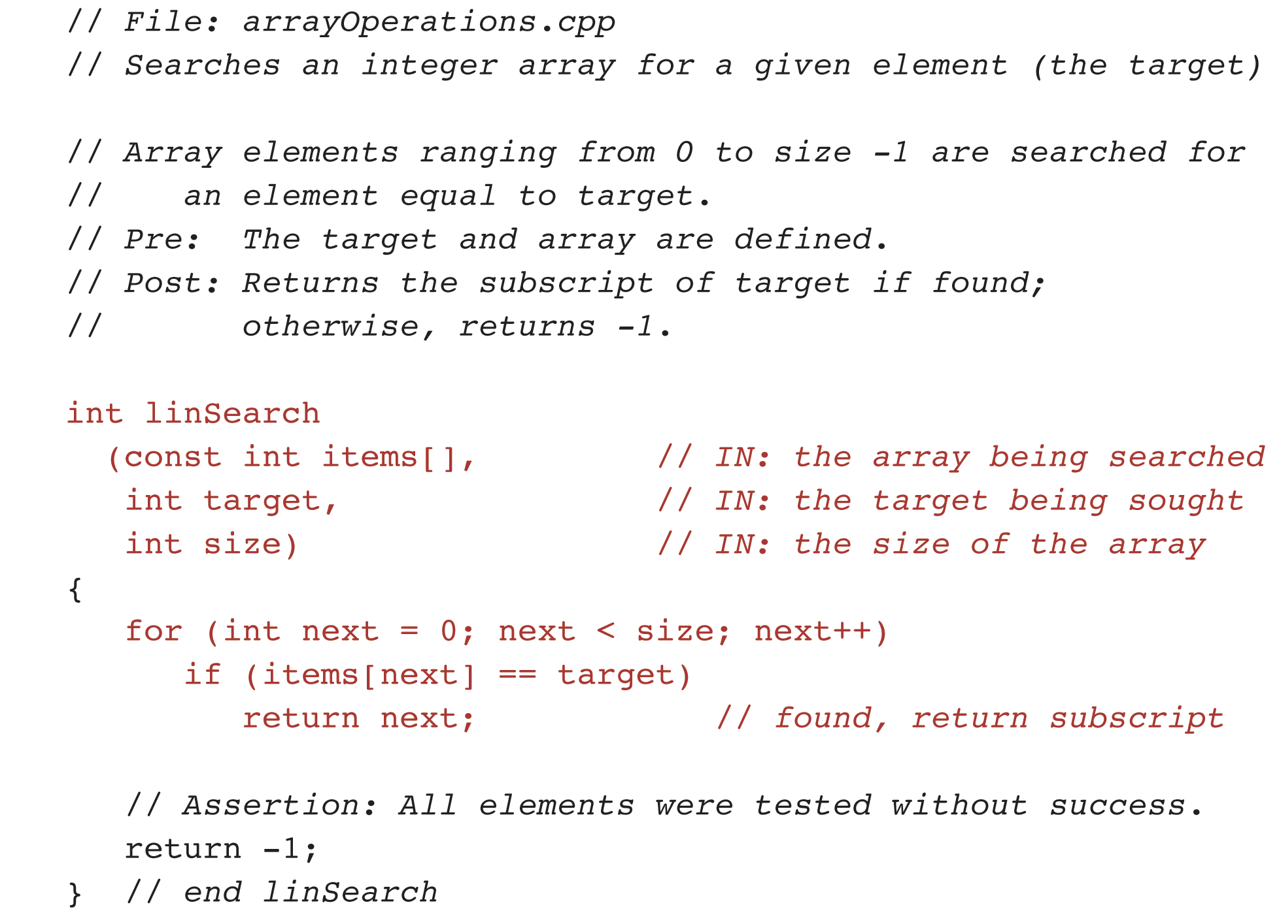
Example: linSearch Function

Slide 25
Is This Correct?
float x[3] = { 16.0, 12.0, 6.0, 8.0 };
No, too many elements for the array.
float x[3] = { 16.0, 12.0 };
Yes, fewer elements is allowed.
float x[3] = { 16.0, 12.0, 42.5 };
Yes, there are exactly three elements.

Slide 26
How Could We Get?
Let’s have:
int arr[5] = {1, 2, 3, 4, 5};
The first element in the array:
arr[0]
The last element in the array:
arr[4]

Slide 27
What Will Be the Result?
void test(int a){
a++;
}
int b = 5;
test(b);
cout << b;
5

Slide 28
What Is the Result?
void test(int & a){
a++;
}
int b = 5;
test(b);
cout << b;
6

Slide 29
What Is the Result?
void test(int a){
a = 10;
}
int b[3] = {1, 3, 4};
test(b[1]);
cout << b[0] << “ “ << b[1] << “ ” << b[2];
1 3 4

Slide 30
What Is the Result?
void test(int& a){
a = 10;
}
int b[3] = {1, 3, 4};
test(b[1]);
cout << b[0] << “ “ << b[1] << “ ” << b[2];
1 10 4

Slide 31
What Is the Result?
void test(int a[]){
a[1] = 10;
}
int b[3] = {1, 3, 4};
test(b);
cout << b[0] << “ “ << b[1] << “ ” << b[2];
1 10 4

Slide 32
What Is the Result?
void test(const int a[]){
a[1] = 10;
}
int b[3] = {1, 3, 4};
test(b);
cout << b[0] << “ “ << b[1] << “ ” << b[2];
Syntax Error

Slide 33
Questions?
Q & A

Slide 34
Multidimensional Arrays
Allows for complex arrangement of data
Can have many dimensions
Syntax:
  element-type arrayName[size1][size2]…[sizeN];
Example:
double table[NROWS][NCOLS];

Slide 35
Declaring Two-Dimensional Arrays
Most common multidimensional array
Represents a table
Example:
char ticTacToe[3][3];
Access to elements:
ticTacToe[1][2]
Row
Column

Slide 36
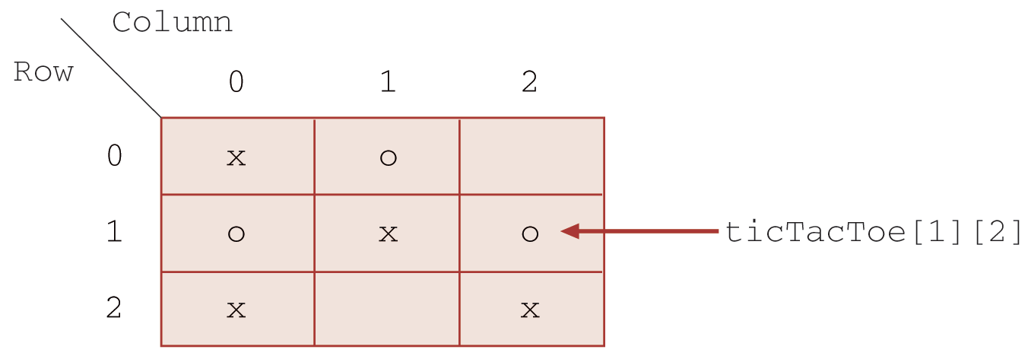
A tic-tac-toe Board Stored as an Array ticTacToe

Slide 37
Example: Classroom Seating Plan
const int NUM_ROWS = 11;
const int SEATS_IN_ROW = 9;
string seatPlan[NUM_ROWS][SEATS_IN_ROW];
. . .
seatPlan[0][8] = "Gerry";

Slide 38
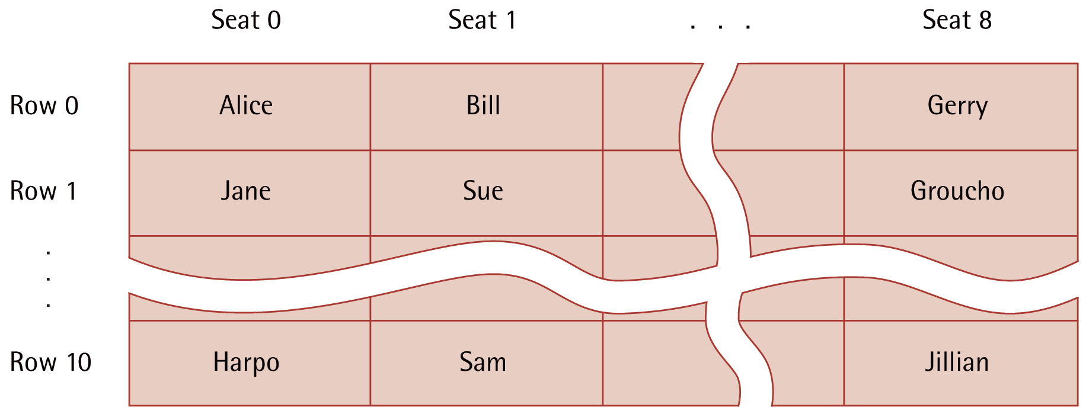
A Classroom Seating Plan

Slide 39
Initialization of Multi-Dimensional Arrays
Each inner pair of braces contains initial values for one row of the array matrix
const int NUM_ROWS = 2;
const int NUM_COLS = 3;
float matrix[NUM_ROWS][NUM_COLS] = {
{ 5.0, 4.5, 3.0 },
{ -16.0, -5.9, 0.0 }
};

Slide 40
Nested Loops for Two-D Arrays
Row order
  Use row subscript as outer loop control variable
Column order
  Use column subscript as inner loop control variable

Slide 41
Two-Dimensional Arrays as Function Arguments
Row dimension can be anonymous, but column dimension must be specified
C++ must know the number of elements in each row in order to access a particular array element

Slide 42
Example: sumMatrix
float sumMatrix(float table[][NUM_COLS], int rows)
{
float sum = 0.0;
// Add each array element value to sum.
for (int r = 0; r < rows; r++)
for (int c = 0; c < NUM_COLS; c++)
sum += table[r][c];
return sum;
}

Slide 43
Arrays with Several Dimensions
const int PEOPLE = 10;
const int YEARS = 5;
double sales[PEOPLE][YEARS][12];

Slide 44
The struct Data Type
struct used to store related data items
Individual components of the struct are called its members
Each member can contain different types of data
Three parts
  Declaration of structure
  Use of structure to define a new variable
  Access of members of the structured variable
Typically declare struct as global

Slide 45
struct Type Declaration
struct struct-type
{
type1 id-list1;
type2 id-list2;
. . .
typen id-listn;
};
struct employee
{
int id;
string name;
char gender;
int numDepend;
float rate;
float totWages;
};
...
employee organist, janitor;

Slide 46
Accessing Members of a struct
organist.id = 1234;
organist.name = "Noel Goddard";
organist.gender = 'F';
organist.numDepend = 0;
organist.rate = 12.00;
organist.totWages = 480.0;
organist.totWages += (organist.rate * 40.0);

Slide 47
Structs as Operands and Arguments
struct copy or assignment
// copy janitor to organist
organist = janitor;
Copies each member from janitor struct to organist struct

Slide 48
Passing a struct as an Argument
Actual and formal parameters must be same type struct
Using structs as arguments can shorten argument list
Passing structs by value can be inefficient, since it duplicates values of all members

Slide 49
Passing struct by Reference
Same as other reference parameters
  Use & to identify in parameter list
Can also use constant reference
  Precede parameter with the reserved word const
  Example:
void printStats(const examStats& stuExams)

Slide 50
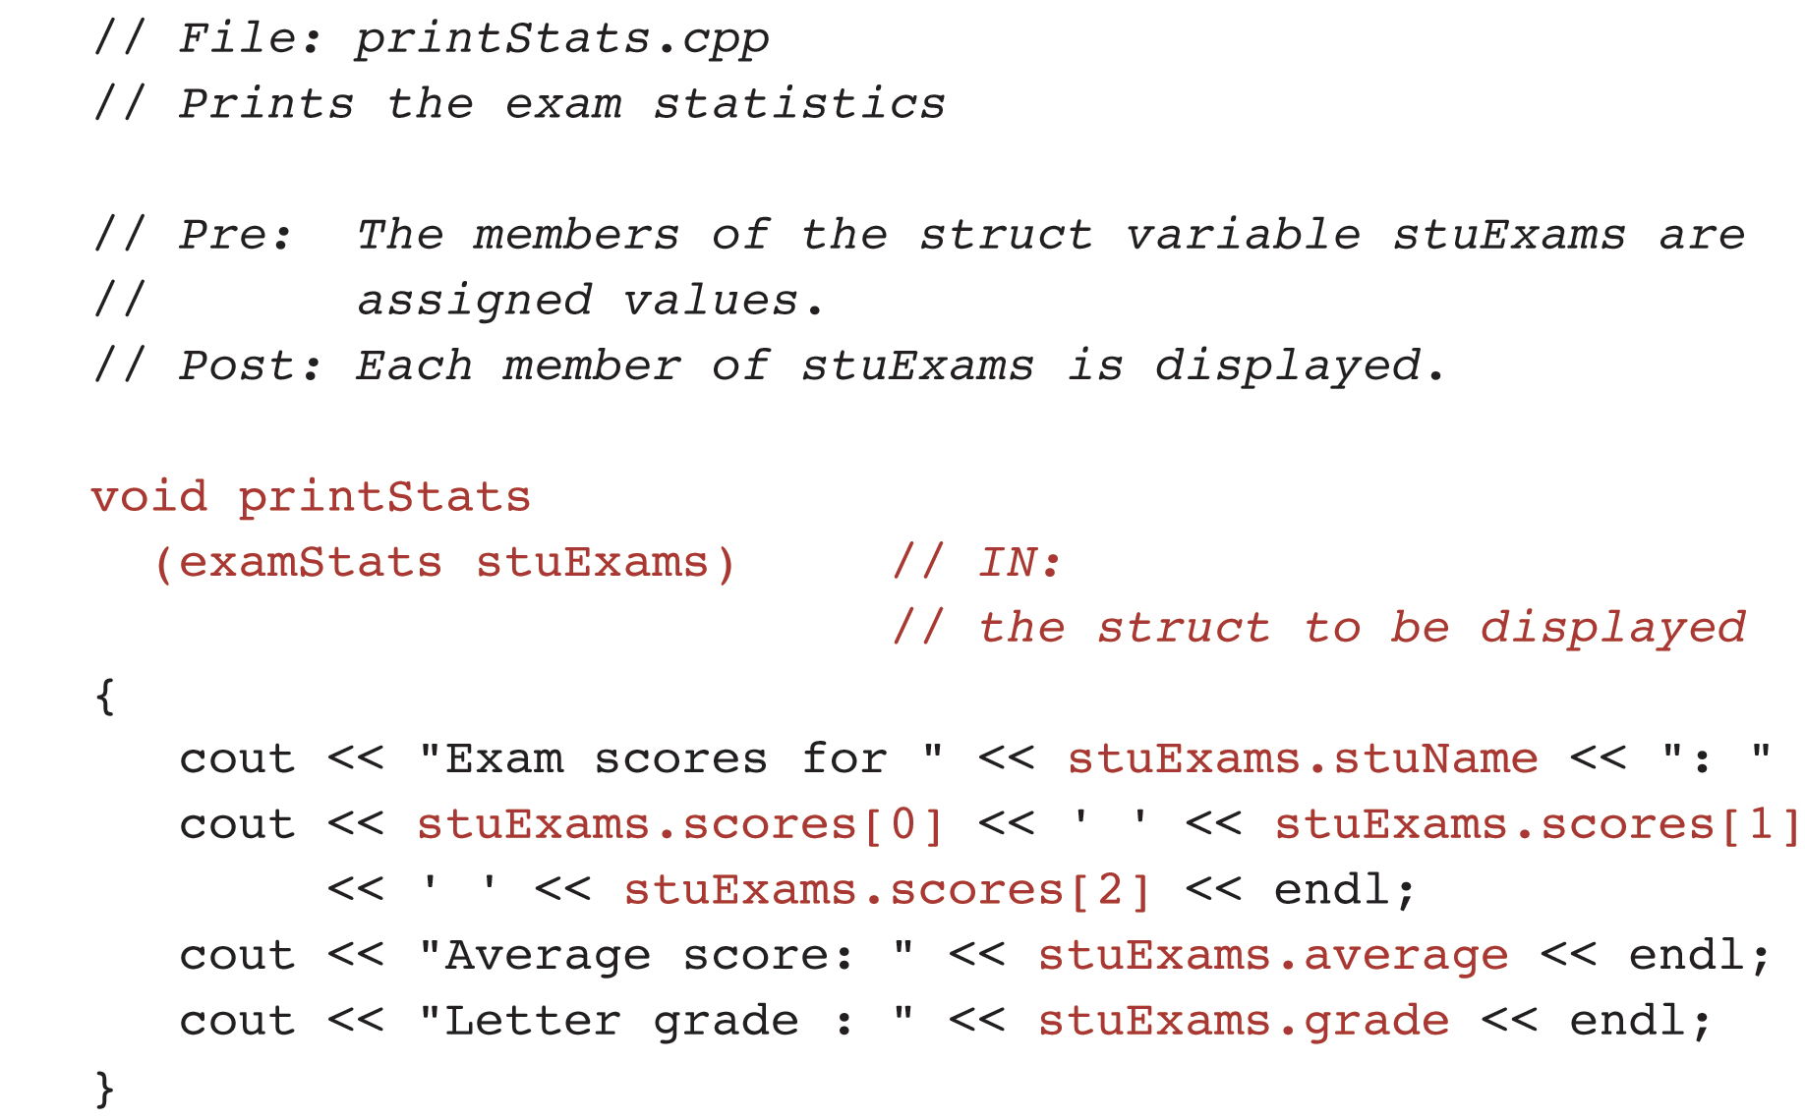
Example: Function printStats

Slide 51
Structs with Arrays as Elements
struct examStats {
string stuName;
float scores[3];
float average;
char grade;
};
examStats stats;
stats.scores[0] = 93.5;
stats.scores[1] = 95.5;
stats.scores[2] = 99.0;
stats.average = 96.0;
stats.grade = ‘A’;
stats.stuName = “NoName”;
Or
examStats stats {“NoName”, {93.5, 95.5, 99.0}, 96.0, ‘A’};
examStats stats;
stats.scores = {93.5, 95.5, 99.0};

Slide 52
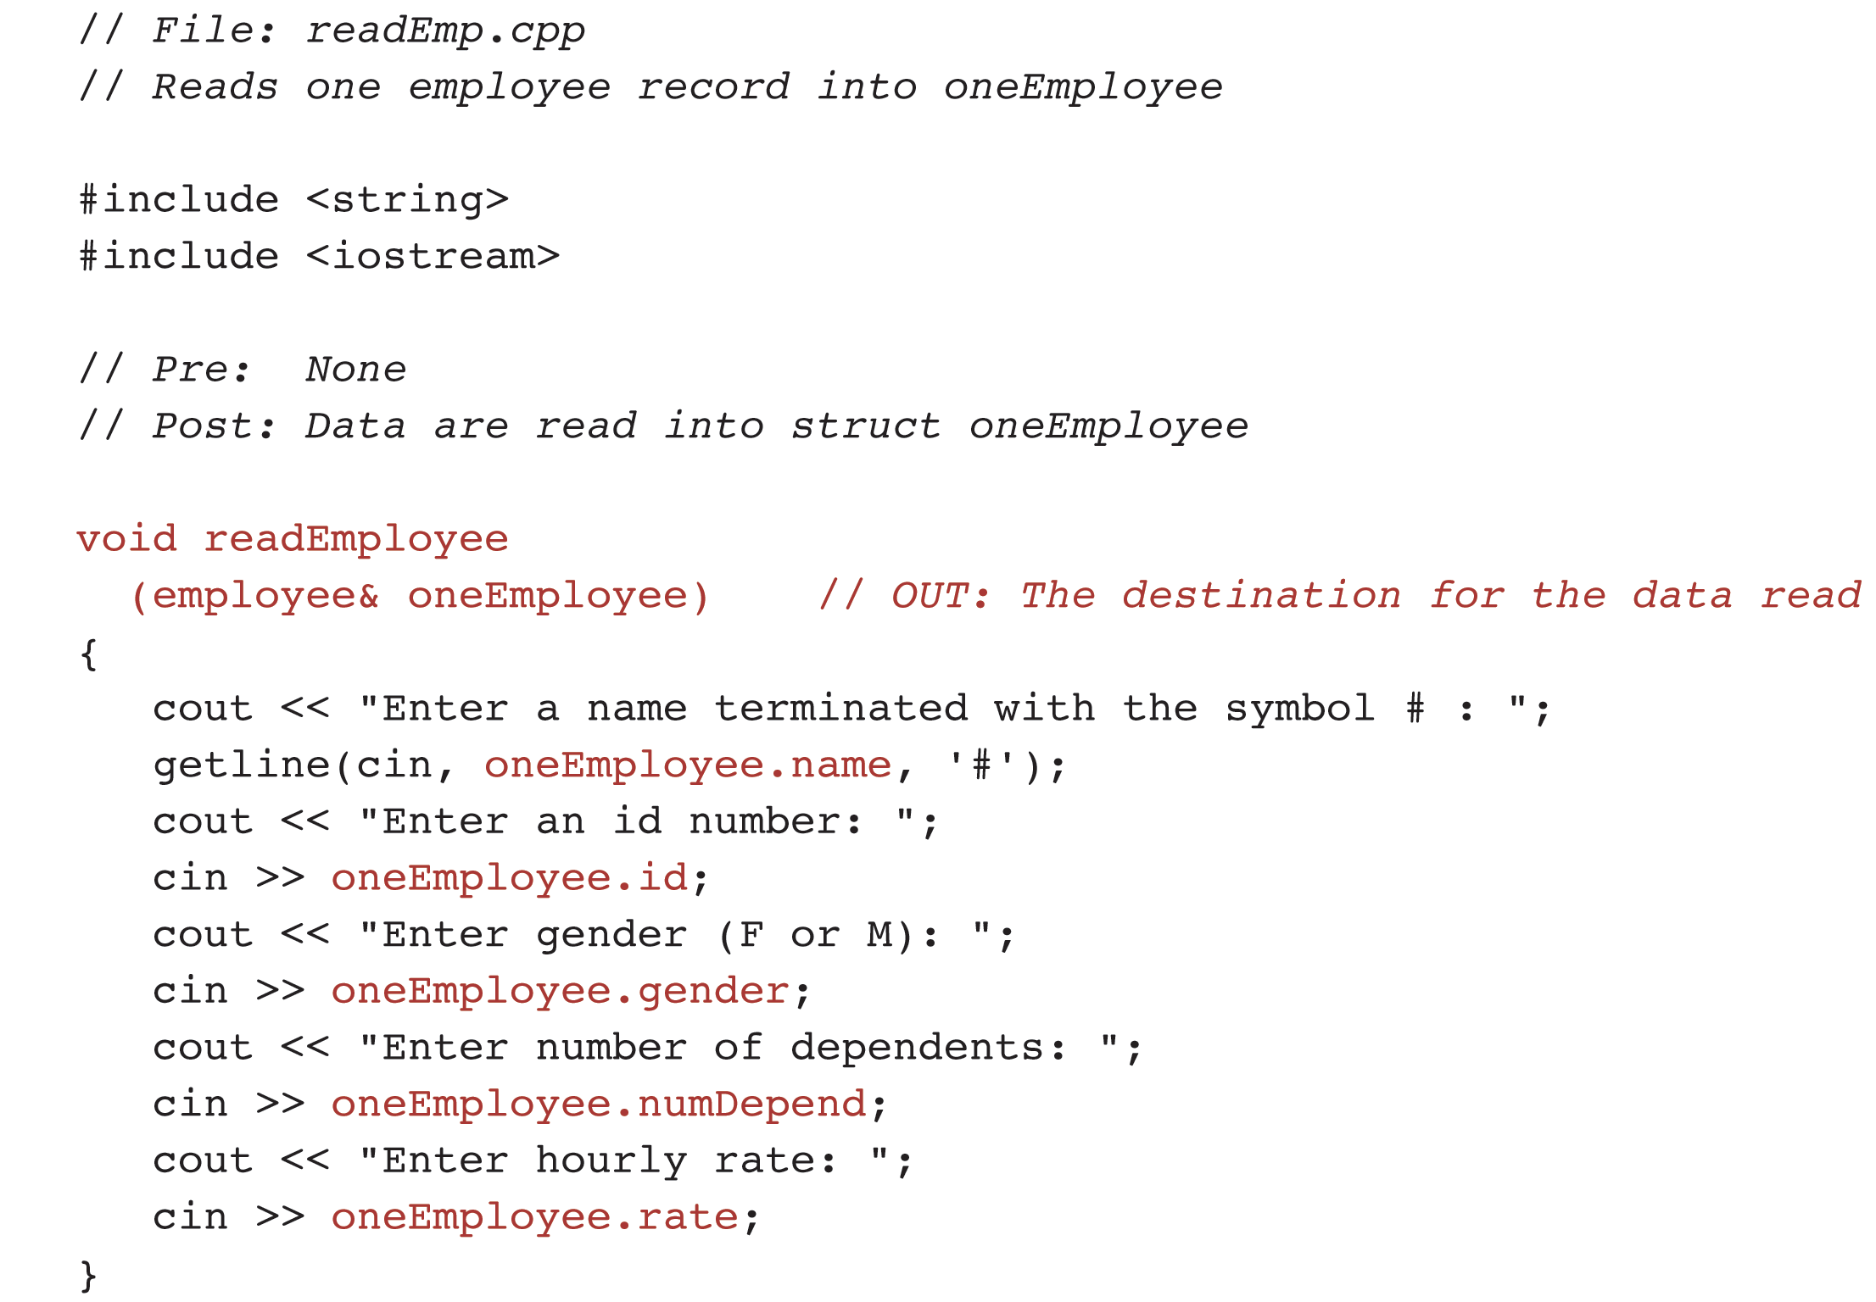
Example: Function readEmployee

Slide 53
Array of Structs
Declaration of an array of structs
employee company[10];
Reserves storage for 10 employee structs
Can pass an element to a function:
readEmployee(company[i]);

Slide 54
Questions?
Q & A

